Slide 1

SIR MV INSTITUTE OF TECHNOLOGY DEPARTMENT OF COMPUTER SCIENCE AND ENGINEERING
An Internship Presentation On
“Data Science”
PRESENTED BY
SATHVIK N G 1MV21CS091
UNDER THE GUIDANCE OF
External Guide Internship Coordinator HOD
Mr.Nooruddin Shaikh Mrs. Rekha B N, Dr. T N Anitha
CTO, VIEH Group Associate Professor, PROF. and HOD
Bengaluru CSE,SIRMVIT CSE, SIRMVIT,

Slide 2
CONTENTS
Company profile
Abstract
Introduction
System requirements and specification
Dataset Overview
Life Cycle of a Data Science Project
Navigating Data Insights
Building the Prediction Model
Screen shots
Conclusion
References

Slide 3
COMPANY PROFILE
V.I.E.H Group is a multidimensional Cyber Security and IT company.
With expertise in various domains, they offer a wide range of services including Web Application Penetration Testing (WAPT), Vulnerability Assessment and Penetration Testing (VAPT), Red Teaming, website development, software development, and private investigation.
They excel in ensuring robust digital security, providing customized solutions to meet client needs, and collaborating with law enforcement agencies to solve complex cases.
V.I.E.H Group stands out as a trusted partner for organizations seeking comprehensive cyber security solutions and reliable IT services

Slide 4
ABSTRACT
This presentation introduces my internship project, which revolves around predicting life expectancy
It encompasses key chapters ranging from data science’s lifecycle and company context to project design, system requirements, model building, and conclusions.

Slide 5
INTRODUCTION
Data science is a rapidly growing field that involves extracting valuable insights and knowledge from large and complex datasets. It combines various disciplines such as statistics, mathematics, and computer science to analyze data, build predictive models, and make data-driven decisions.
This data science project aims to predict life expectancy by analyzing a diverse dataset that encompasses various health and socio-economic factors. The project explores the application of machine learning techniques to uncover patterns and insights related to life expectancy trends. Through this endeavor, valuable insights into public health can be gained.

Slide 6
SYSTEM REQUIREMENT AND SPECIFICATION
Hardware Requirement Specification:
Processor: Intel Core i5 processor or equivalent
Memory: 8 GB RAM (Recommended)
Hard Disk: 500 GB
Software Requirement Specification:
Operating System: Windows 10 or macOS Mojave (or later) or Linux (Ubuntu 18.04 or later)
Python 3.7 or higher
Jupyter Notebook or any preferred code editor
Python libraries: Pandas, NumPy, Scikit-learn, Matplotlib, Flask
Frontend Tools : HTML, CSS
Version Control : Git and Github
Deployment : Render

Slide 7
DATASET OVERVIEW
Sample File Name: life expectancy data.csv
Number of Columns: 21
Number of Rows: 2938
Columns Name: Year, Status, Adult Mortality, Alcohol, Hepatitis B, Measles, BMI, Under-five deaths, Polio, Total expenditure, Diphtheria, HIV/AIDS, GDP, Population, Thinness 1-19 years, Income composition of resources, Schooling
Columns Datatype: int64, float64

Slide 8
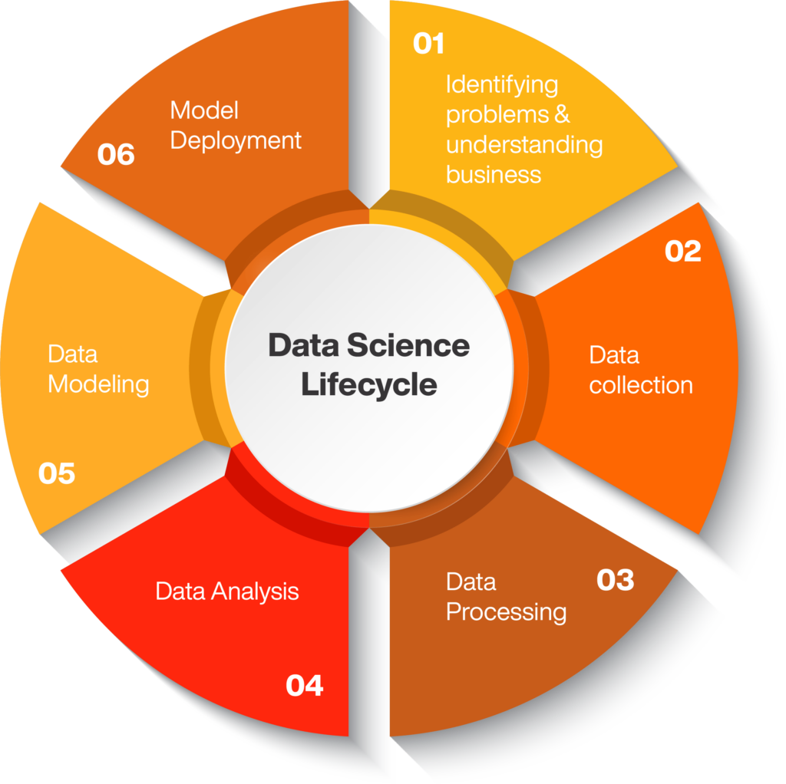
LIFECYCLE OF A DATA SCIENCE PROJECT

Slide 9
NAVIGATING DATA INSIGHTS
Data Collection: Acquiring the dataset with health, economic, and lifestyle data.
Data Pre-processing: Cleaning and preparing data for analysis. This includes basic description of dataset as well as handling missing values and outliers in the dataset, which was handled using random imputation method.
Exploratory Data Analysis (EDA): Finding patterns and relationships in the data. This includes creating visualizations like histograms, scatterplots to understand data better
Feature Selection: Choosing significant factors influencing life expectancy. This includes forming a correlation matrix which showed relationship between different features.

Slide 10
BUILDING THE PREDICTION MODEL
Model Training: Training the model to predict life expectancy using a linear regression technique. This include dividing data into train and test sets, separating life expectancy from feature matrix(X) and extract it to target variable (Y) and training the model on the train set
Model Evaluation: Evaluating the model’s performance on test set. Assessing model performance using various metrics such as mean-squared and root-mean-squared errors. Predicting the target variable for test set. Examining residuals and calculation of coefficients of life expectancy with other features
Web Application Development: Creating User-Friendly Interface using HTML and CSS, and integrating it through Flask Framework to ensure smooth interaction and user experience.
Deployment and Testing: Creating an accessible predictor, deploying on platform named Render, and ensuring it works well
Documentation: Creating a detailed report summarizing the entire project.

Slide 11
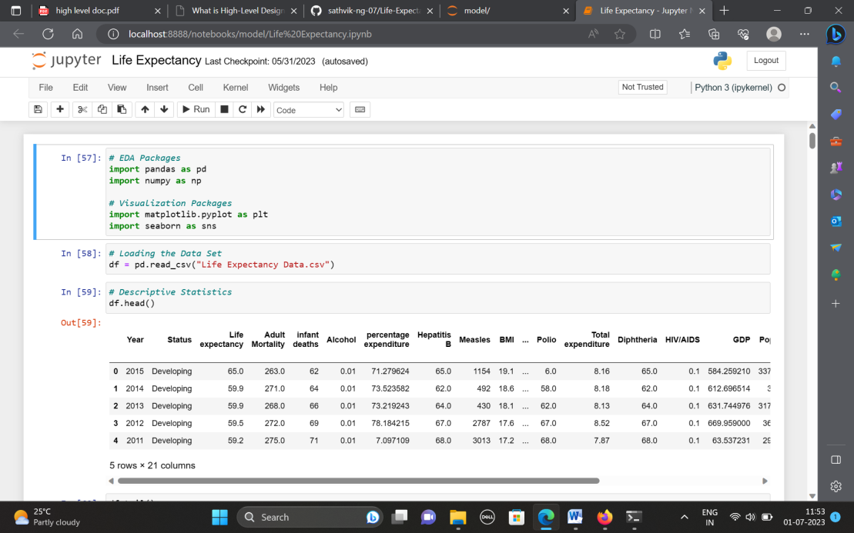
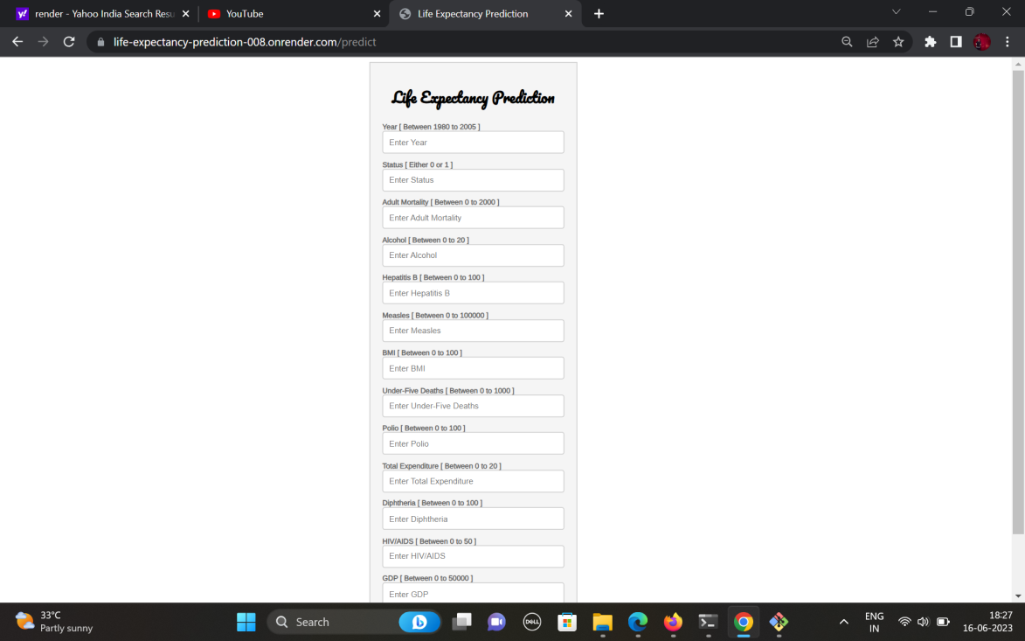
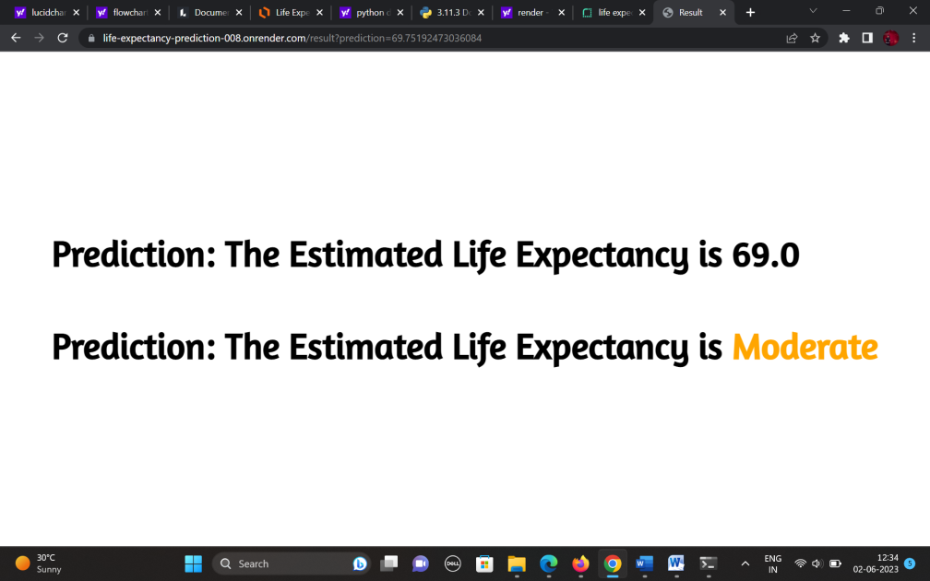
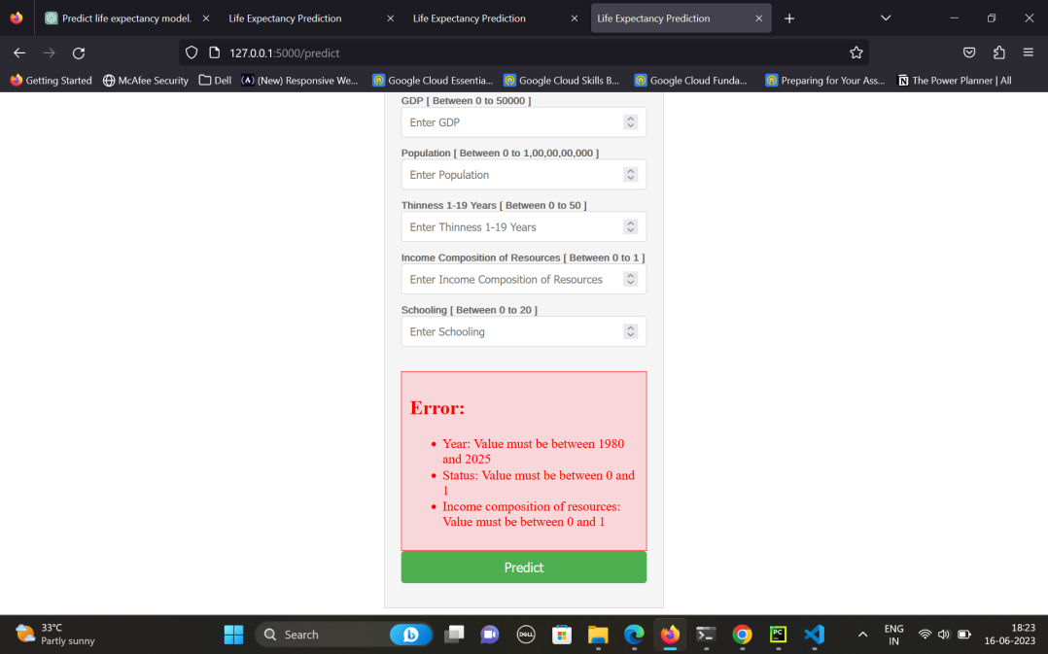
SCREENSHOTS

Slide 12
CONCLUSION
Life expectancy isn't just a number; it's a story told by data!

Slide 13
REFERENCES
1. HTML Tutorial (w3schools.com)
2. CSS Tutorial (w3schools.com)
3. 3.11.4 Documentation (python.org)
4. NumPy Documentation
5. pandas documentation — pandas 2.0.3 documentation (pydata.org)
6. Matplotlib documentation — Matplotlib 3.7.2 documentation
7. Project Jupyter Documentation — Jupyter Documentation 4.1.1 alpha documentation
8. Welcome to Flask — Flask Documentation (2.3.x) (palletsprojects.com)
9. scikit-learn: machine learning in Python — scikit-learn 1.3.0 documentation
10. Project demo - https://youtu.be/hgw2KTCChL0
11. Github Repository - https://github.com/sathvik-ng-07/Life-ExpectancyPrediction.git

Slide 14
THANK YOU

